Slide 1
Timestamp hacking-Proof Blockchain Based Online Voting System
By
Megha Manjunath Raykar, Harkanwaldeep Singh Saini,
Divyaa Thellore Venkataraman, Smitha Venkatesh
Under guidance of
Prof.Richard Sinn

Slide 2
Introduction
Problems with online voting :
Problems with Ballot voting :
fraudulent sites, phishing attacks, hostile middle man attacks
lost, stolen, tampered with...
These problems can be avoided by using blockcahin

Slide 3
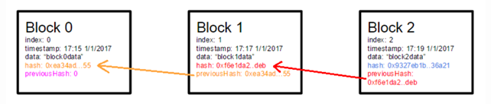
What is blockchain
It involves marking each block of voter’s data and unique voter’s token with a hash function and including the previous block’s hash function in the next block’s hash function. Thus, using this modified blockchain for casting votes ensures legitimacy and avoids tampering of votes.

Slide 4
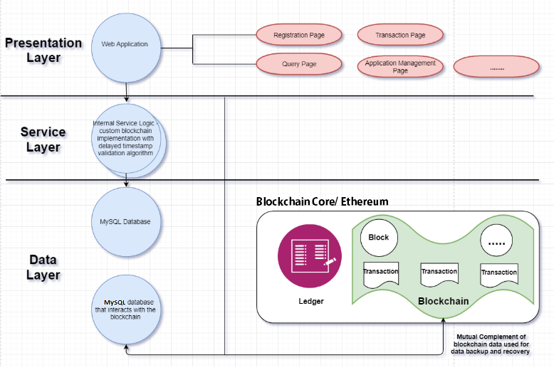
Project Architecture

Slide 5
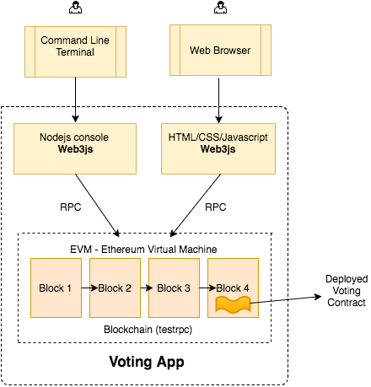
Architecture Sub-systems

Slide 6
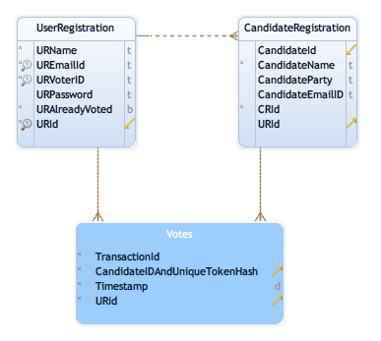
Technology Descriptions
Client Technolog(y)ies
HTML,
CSS,
JavaScript
and it’s libraries like Jquery
bootstrap
Middle-Tier Technolog(y)ies
Node express package
Ganache
Truffle
Testnet
Smart Contracts using Solidity
Data-Tier Technolog(y)ies
MySQL
ER Diagram

Slide 7
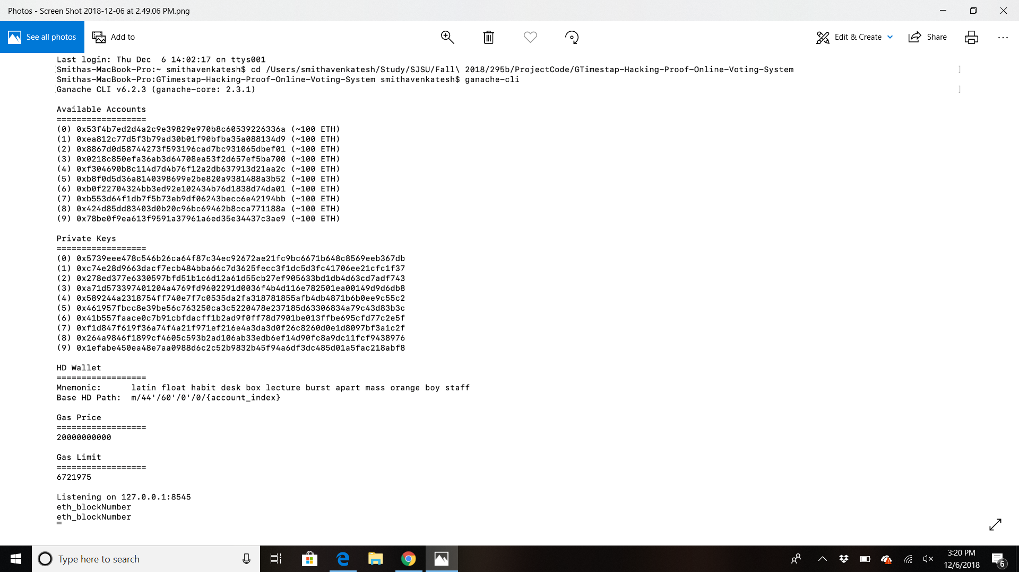
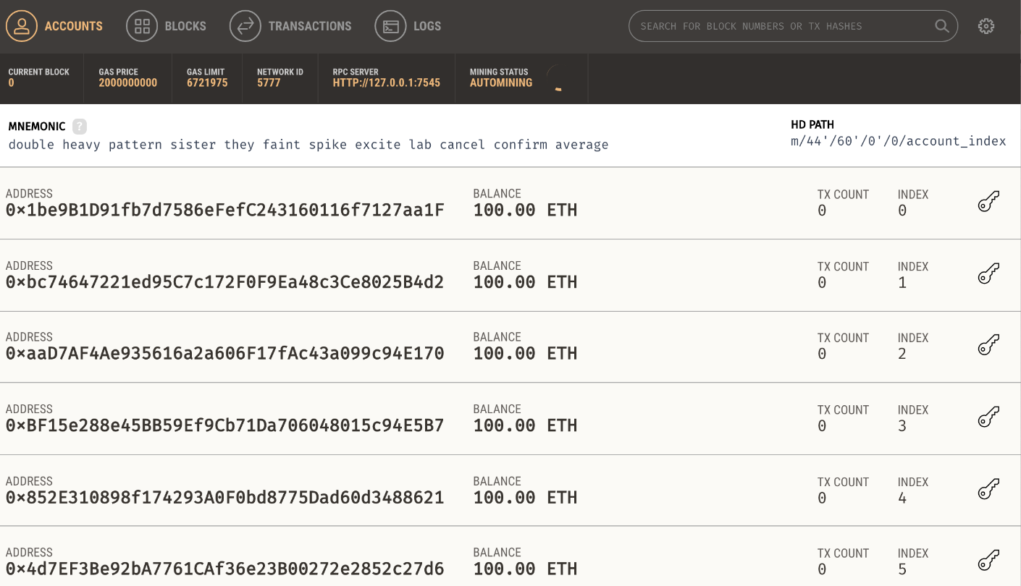
Results and Analytics
Account IDs and the respective secure keys
Ganache GUI

Slide 8
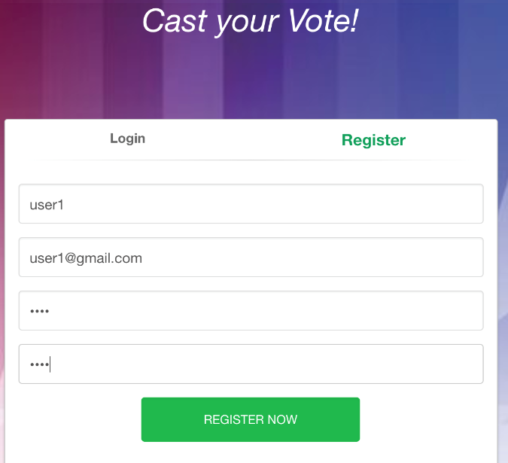
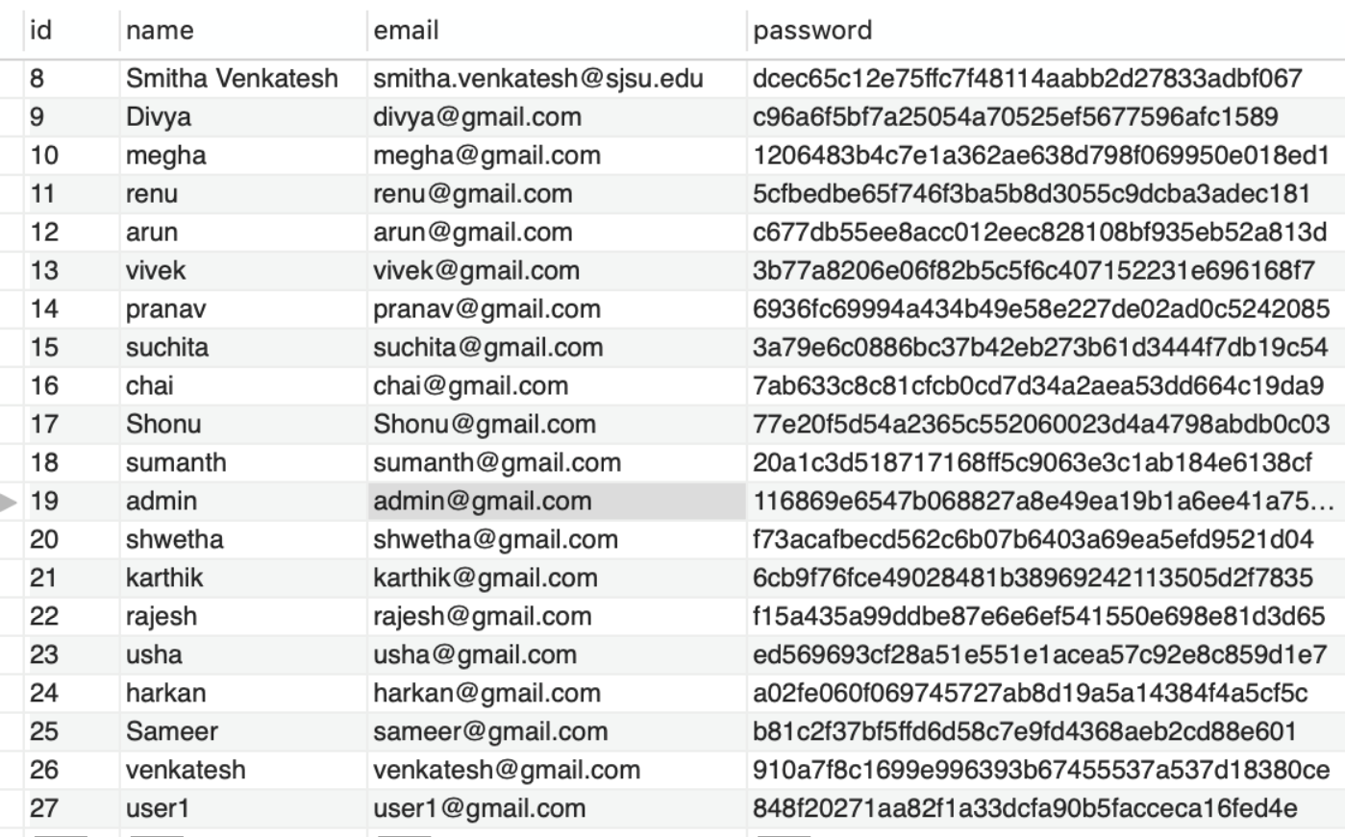
Results and Analytics (cont.)
Log in screen
DB entries

Slide 9
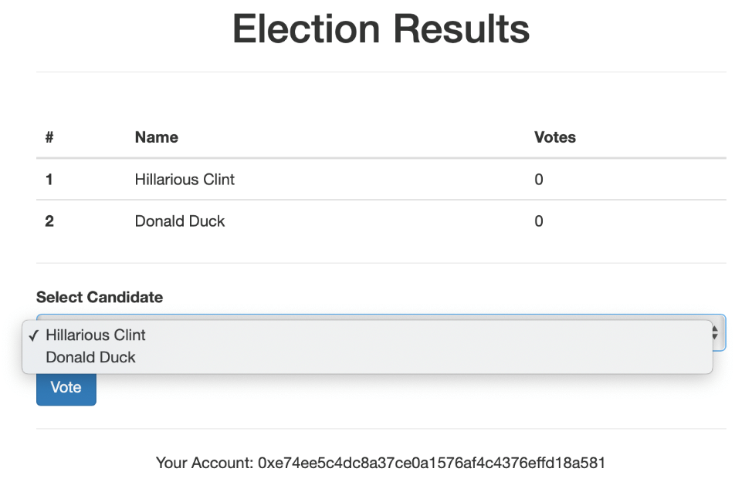
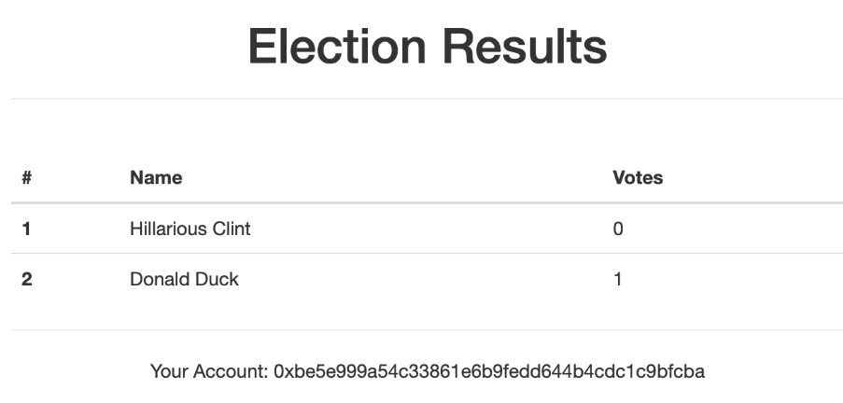
Results and Analytics (cont.)
The user casting vote page
The admin secure section that displays the election results.

Slide 10
Conclusion
Future Work
Through our project we achieved the following :
Avoid the traditional ballot voting
Avoid the tampering of the votes
Introduce security for sensitive data
Make changes to the data impossible and detectable
Mitigate the effects of timestamp hacking
The UI can be made more appealing pertaining to all the UI design criteria and design patterns
The blockchain technology faces problems like double spending and poison pill attack which can be mitigated by implementing specific algorithms

Slide 11


